Slide 1
ConnectionsBot
CSC 480: Artificial Intelligence
Max Allworth-Miles, Owen Lutz, Gauransh Thapar

Slide 2
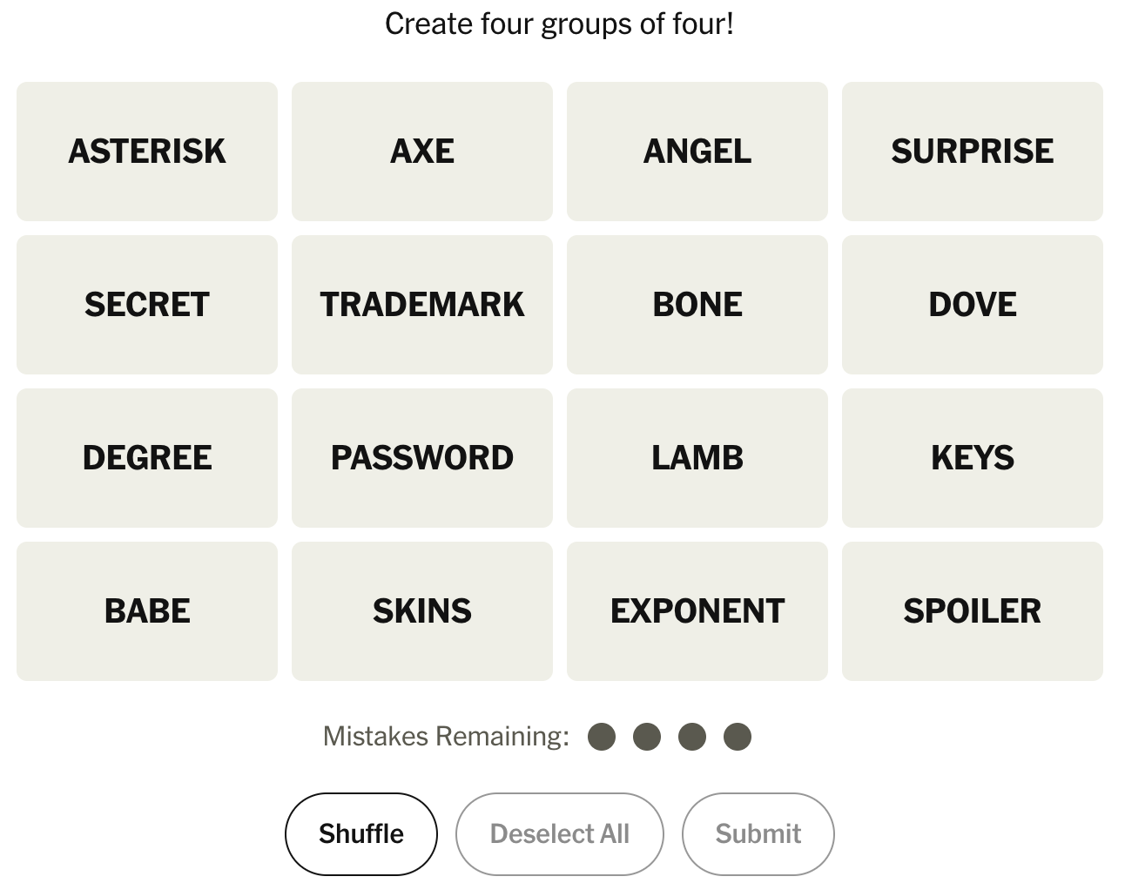
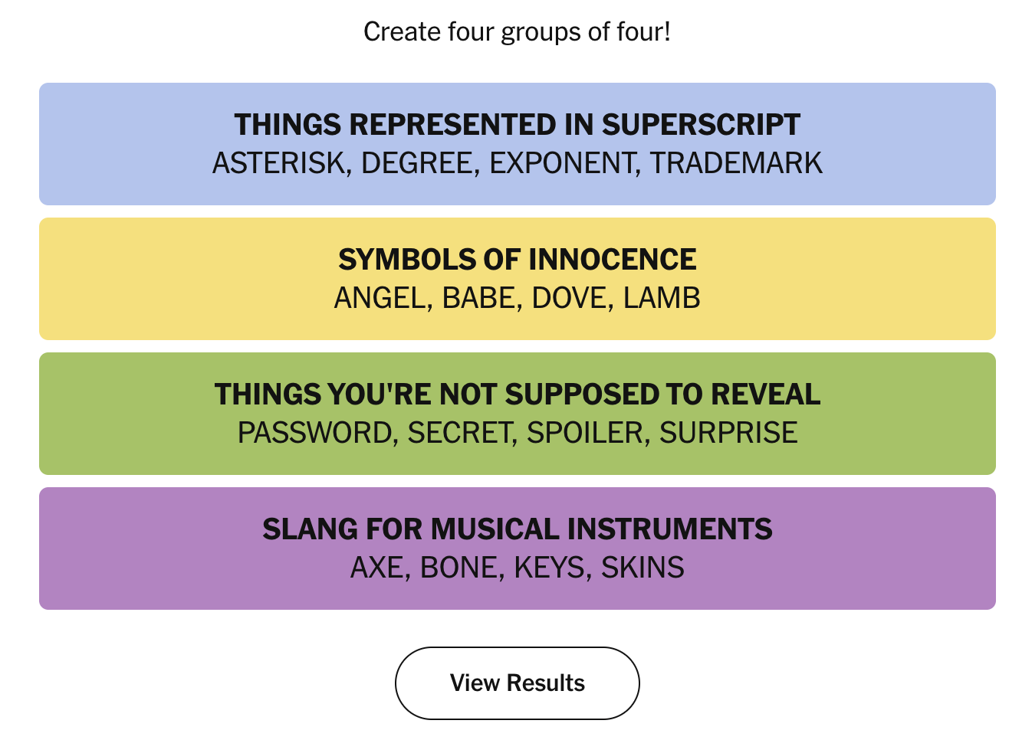
Connections
Notes:
MAX
Connections is a New York Times game where the objective is to take a 4x4 grid of words and correctly sort them into 4 groups, where each group has some theme. Themes could be as simple as 4 synonyms, or involve complex wordplay or popular culture references.
There can be 4 mistakes made before the game is lost. If a guess is correct, you get to see the “theme” and the “category” which is a color. If 3 of 4 guessed words belong to the category, the game tells you that your guess is “one away” from a correct guess, but counts it as a mistake.

Slide 3

Goal
Build an intelligent system capable of solving Connections
Notes:
MAX
Our goal, following the focus of this class, was to build a system with some form of intelligence that enables it to win Connections games

Slide 4
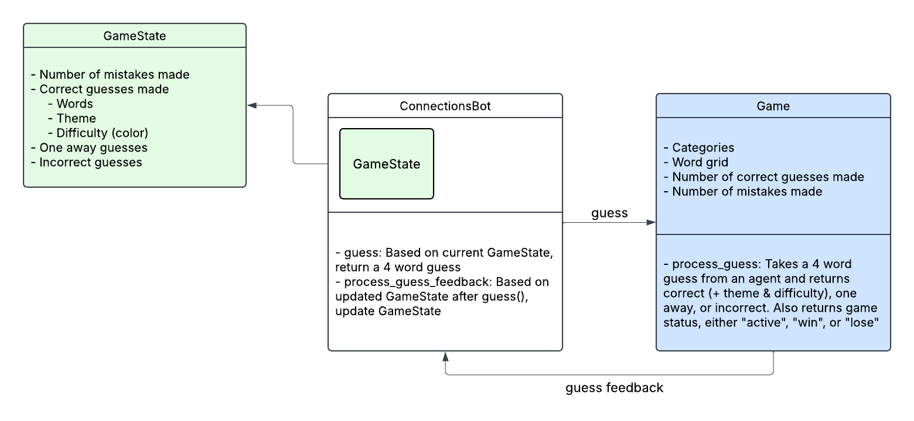
System Design
Notes:
MAX

Slide 5
Guessing Heuristics

Slide 6
Embedding Similarity
Word embeddings: high dimensional vectors representative of a words meaning
Method: Take the average cosine similarity between every pair of word vectors in every 4 word combinations, return the “most similar” (lowest mean cosine similarity) 4 words.
Works well for groups of synonyms and groups of related words with a single dominant sense.
Overall the best general use heuristic due to performance and efficiency.
Notes:
MAX

Slide 7
WordNet
Database of English words grouped by relationship (mostly interested in synonyms), with multiple distinct senses for words.
Should perform better on groups that are synonyms of uncommon senses of words (ex: “bank” as in a river bank, not a financial institution).
Method: For each word, find synonyms for each of its senses. If 3 synonyms are available words in the game, group into a guess.
Didn’t make any correct guesses using this method, removed from final program to save time
Notes:
MAX

Slide 8
Character Insertion
Connections categories often involve wordplay, this approach aims to solve a specific type
Game Ex: “FOUNDER”, “SALON”, “SURGEON”, “TROT” →
“FLOUNDER”, “SALMON”, “STURGEON”, “TROUT” (Fish minus a letter)
Method: Insert characters into various positions in words. If resultant strings are valid english words, store them and take the average cosine similarity (borrowed from embedding similarity method) to find the 4 most similar modified words.
Notes:
MAX

Slide 9
Homophone Similarity
Homophone: A word that is pronounced the same as another word but differs in spelling
Method: Find homophones of available words. Take the average cosine similarity between homophones (borrowed from embedding similarity method) to find the 4 most similar homophones, and return the original words.
Game Ex: “AWL”, “NUN”, “PHEW”, “SUM” →
“ALL”, “NONE”, “FEW”, “SOME” (Homophones of non-numeric amounts)
Notes:
MAX

Slide 10
Subgroup Synonyms
Detect hidden word relationships by finding meaningful subwords inside each word, such as prefixes, suffixes, or other substrings. Ex: Clop, Cutter have “cut” and “lop”
Method: for each word, generate candidate subwords and score groups of four based on shared synonyms
Either gets it right, or is useless.
Computationally expensive
Notes:
Owen
The scored search works by generating many possible hidden subwords from each board word, such as prefixes, suffixes, and middle chunks, then assigning each candidate a score based on how useful it seems: real-looking words, suffixes, longer chunks, and non-junk endings get rewarded, while common meaningless fragments like ing or ion get penalized
For each group, the bot may consider multiple hidden candidates per word, like prefixes, suffixes, and middle chunks. So instead of scoring 1,820 simple groups, it might be scoring thousands or tens of thousands of hidden-subword combinations. Then each score may require expensive operations like embedding comparisons or WordNet synonym lookups.

Slide 11
Low Hanging Fruit
If there's only four left, pick them
One-away, if we guessed a group which only had one wrong, focus on getting this group. In the aggregator, increase the bonus for groups with three of these words.
Notes:
Owen
The one-away rule uses feedback from a near miss: if the bot guesses four words and the game says it was “one away,” then three of those words are correct and only one is wrong, so future guesses should prioritize repairing that group by keeping combinations of three words from the near-miss guess and swapping in one remaining word until it finds the correct category

Slide 12
Ideas we tried!
We needed to combine the outputs of the heuristics in a useable way, so we tried a bunch of methods to solve the game problem.
A Simple single guess method where we pick the best embedding match from among all the possible 4 words groups. We only update weights for other heuristics as we progress through solving easier levels.
Weighting heuristics for each guess (starting heavy on embedding) and returning the highest weight guess.
Rotating between the strategies based on events, starting with embedding. We got the idea of Event-Action model after trying this method
The first version of the bot was a strong baseline: it evaluated one guess at a time and chose the best locally scored option.
Notes:
Gauransh
The aggregator treats each heuristic as a source of evidence. It adjusts each candidate using a confidence multiplier, combines scores for identical guesses, adds small bonuses for overlapping guesses, and chooses the group with the strongest total support.

Slide 13
Ideas we tried!
Then we moved to trying more complex ideas of combining guesses to make a set of 4 groups, and we assign each set a TOTAL score.
Aggregate Method: Each heuristic returns a set of candidate groups, and the aggregator combines scores for identical guesses, adds bonuses for overlapping guesses, and chooses the group with the strongest total support.
Weighted Heuristics per Group: score each candidate group with different heuristic mix formula depending on its position in the remaining solution path, then choose the full set with the strongest overall weighted score.
Notes:
Gauransh
The aggregator treats each heuristic as a source of evidence. It adjusts each candidate using a confidence multiplier, combines scores for identical guesses, adds small bonuses for overlapping guesses, and chooses the group with the strongest total support.

Slide 14
Weighted Heuristics per Group: We finally moved into this direction and came quite far (The bot could be improved a lot)
After making a lot of changes for performance/efficiency
The Final bot does not just pick the best single guess.
It generates many valid 4-word candidates for each group slot scored on the group’s weightage formula.
Then it creates a strongest shortlist for each group.
It picks up the best from each group to form a valid set of 4 groups.
Finally, it keeps going until it combines non-overlapping words/groups into full solution sets.
It assigns a TOTAL score to each set, which is the sum of the scores of each of its groups combined. Builds a small ranked set list.
The bot submits the next group from a set with highest TOTAL score.
Notes:
Gauransh
The aggregator treats each heuristic as a source of evidence. It adjusts each candidate using a confidence multiplier, combines scores for identical guesses, adds small bonuses for overlapping guesses, and chooses the group with the strongest total support.

Slide 15
Event - Action Model
How Feedback Changes the Strategy:
Correct guess:-
Keep the current Set, and remove the solved group. Return next guess.
One-away:-
Look for another set lower in the ranked hierarchy whose next submitted group differs from the one-away guess by exactly one word. Discard all other.
Incorrect:-
Discard the exact failed group. Look for other sets.
Strictly reject groups that share 3 words with a fully incorrect guess.
This prevents the bot from repeating a dead core.
Notes:
Gauransh
The aggregator treats each heuristic as a source of evidence. It adjusts each candidate using a confidence multiplier, combines scores for identical guesses, adds small bonuses for overlapping guesses, and chooses the group with the strongest total support.

Slide 16
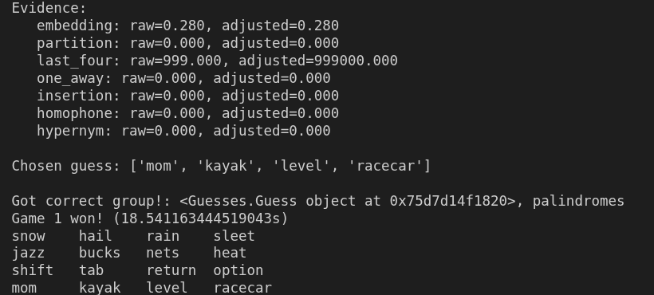
Findings from an older version
1. Standalone first-guess quality by heuristic
Heuristic Exact One-away Wrong
embedding 15 ( 75.0%) 3 ( 15.0%) 2 ( 10.0%)
phrase 3 ( 15.0%) 0 ( 0.0%) 0 ( 0.0%)
insertion 4 ( 20.0%) 3 ( 15.0%) 13 ( 65.0%)
homophone 0 ( 0.0%) 0 ( 0.0%) 0 ( 0.0%)
2. Exact standalone hits by color
Heuristic YELLOW GREEN BLUE PURPLE
embedding 9 2 2 2
phrase 0 0 0 3
insertion 1 1 0 2
homophone 0 0 0 0
3. One-away standalone hits by nearest color
Heuristic YELLOW GREEN BLUE PURPLE
embedding 1 1 1 0
phrase 0 0 0 0
insertion 1 0 0 2
homophone 0 0 0 0
Notes:
Gauransh. Based on the Findings.txt

Slide 17
Performance Tests(these are old now, due to changes after presentation)
Win rate: 0.06
Games played: 250
Games won: 15
for, GROUP_PROFILE_WEIGHTS = {
"Group 1": {"embedding": 1.5, "phrase": 1.0, "insertion": 0.0, "homophone": 0.0},
"Group 2": {"embedding": 1.5, "phrase": 1.0, "insertion": 0.0, "homophone": 0.0},
"Group 3": {"embedding": 1.0, "phrase": 0.85, "insertion": 0.40, "homophone": 0.25},
"Group 4": {"embedding": 1.0, "phrase": 0.7, "insertion": 0.4, "homophone": 0.4},
}
Win rate: 0.088
Games played: 250
Games won: 22
for, GROUP_PROFILE_WEIGHTS = {
"Group 1": {"embedding": 1.5, "phrase": 0.0, "insertion": 0.0, "homophone": 0.0},
"Group 2": {"embedding": 1.5, "phrase": 0.0, "insertion": 0.0, "homophone": 0.0},
"Group 3": {"embedding": 1.0, "phrase": 0.0, "insertion": 0.0, "homophone": 0.0},
"Group 4": {"embedding": 1.0, "phrase": 0.0, "insertion": 0.0, "homophone": 0.0},
]

Slide 18
Design decisions for efficiency
Why Efficiency Matters?
When we moved towards the sets ideas, a strong solver cannot afford to run every expensive heuristic on every candidate in a reasonable time.
We found that embedding heuristic is very much cheaper than other heuristics, and the phrase heuristic gets a lot more complex as we increase the word checks.
So we may have to add some global controls to tweak a balance between the Bot’s performance in the game and the reasonable computational effort it makes for each game.
Notes:
Gauransh

Slide 19
Design decisions for efficiency
The bot uses a filter for phrase heuristic:
Cheap scoring first, using a GLOBAL_CANDIDATE_PREFILTER
The embedding heuristic is used to make a shortlist of valid candidates
Expensive heuristics like phrase only used on shortlisted candidates
We place a limit on the words that Phrase heuristic can match with, considering that it is the most expensive heuristic. (We tried, but discarded this)
We placed 250 word limit on Phrase heuristic
Heuristic Gating by Weight: (This became very useful for pruning, so it’s kept)
A weight of 0 means the heuristic is skipped entirely for that group.
Notes:
Gauransh

Slide 20
Future Work | Now has been implemented after presentation
More guessing strategies! Connections is a very complex game, and covering more answer types could help performance
We will tweak all the weights and other variables to find a sweet spot between the heuristics for each group.
- Right now the Bot easily solves 1 or 2 groups, but struggles to move ahead.
We will use an eligibility check for Homophone and Insertion heuristic and use the weights as a switch to admit them only if they make any sense.
Notes:
Everyone can add stuff they’re interested in related to the project here

Slide 21
Please go through the README! It contains a lot more details about the latest project’s problem solving aspect.This is added after the presentation

Slide 22
Thank You!

